Slide 1
ASTDD Communications Committee Spotlight

Slide 2
Interim Protocol for Preventive Dental Care in Public Health Settings
Jayanth Kumar, DDS, MPH
State Dental Director
Office of Oral Health, California Department of Public Health
Notes:
Thank you for inviting to participate in this symposium.
Today, I am going to discuss my experience from two states. California mandated fluoridation and increased the % of the population on fluoridation.
New York State has a long history with fluoridation beginning in 1945. It was Dr. David Ast who proposed fluoridation in New York State in 1944 and was about to fluoridate Newburgh but was told to delay it by Dr. Trendly Dean. Newburgh should get the credit for being the first city to undertake fluoridation.
New York state passed a law in 2015 that amended the fluoridation law requiring communities to take steps before making a decision to stop fluoridation, and also established a grant program to support fluoridation. It took years of work and community engagement to accomplish this.

Slide 3
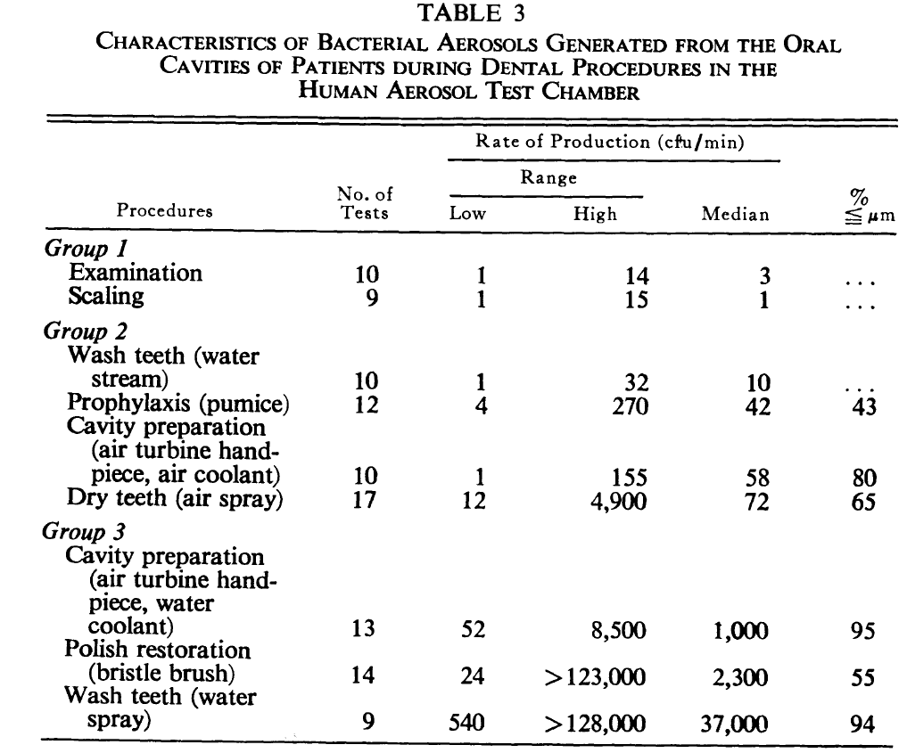
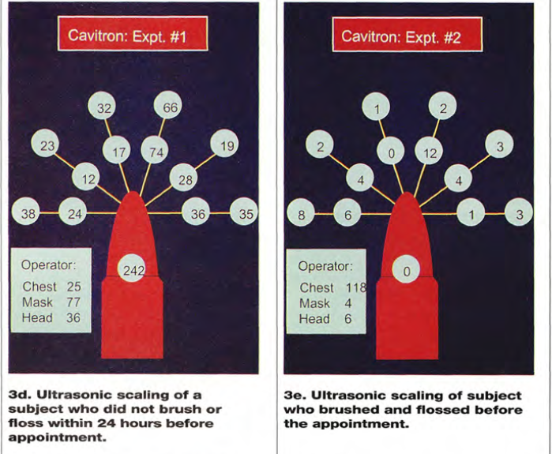
EVALUATING SPATTER AND AEROSOL CONTAMINATION
DURING DENTAL PROCEDURES
CAROLVN D. BENTLEY, D.D.S.; NANCY W. BURKHART, R.D.H., M.ED.; JAMES J. CRAWFORD, M.A., PH.D. JADA, Vol. 125, May 1994
Studies on Dental Aerobiology: I. Bacterial Aerosols Generated during Dental Procedures. RUDOLPH E. MICIK, ROBERT L. MILLER, MAURICE A. MAZZARELLA, and GUNNAR RYGE.
J Dent Res Januarv-February 1969

Slide 4
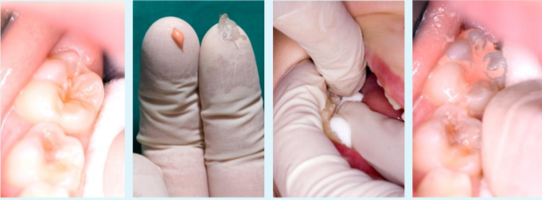
Protocol
Dental prophylaxis using
scalers, toothbrush and selective polishing
Dental Sealants
Clean with a toothbrush
Use cotton tips and gauzes
Employ four handed dentistry
Use glass ionomer sealants
Fluoride varnish
Silver Diamine Fluoride (SDF)
Source: Prevention and Management of Dental Caries in Children. Dental Clinical Guidance. Scottish Dental Clinical Effectiveness Program. 2018

Slide 5
Key Messages
Inform patients that some procedures may be different
Communicate with patients before appointment and ask them to brush and floss
Remind patients:
Routine home care is vital
Replace toothbrushes when bristles begin to fray or after illness
If you have a dental emergency, call your dental office

Slide 6
Q & A

